Slide 1

LINUX OPERATING SYSTEM
PRESENTED By
1. NEELAM GOUR (205116049)
2. PAL SANJAY (205116075)
3. RAMASHEESH (205116051)
4. RAVI PATIDAR (205116053)

Slide 2
HISTRY Of Linux
• Free operating system based on UNIX standards .
• UNIX is a proprietary OS developed in the 60’s, still used for mainframes
• First version of Linux was developed in 1991 by Linus Torvalds.
• Goal was to provide basic functionality of UNIX in a free system
• Version 0.01 (May 1991): no networking, ran only on 80386-compatible Intel processors and on PC hardware, had extremely limited device-drive support, and supported only the Minix file system
• Version 2.6.34 (Summer 2010): most common OS for servers, supports dozens of file systems, runs on anything from cell phones to super computers All of this has been contributed by the Linux community

Slide 3
LINUX
written in :: Primarily C & assembly
OS family :: Unix-like
kernel type :: Monolithic (Linux kernel)
The most popular Linux distributions are:
Ubuntu Linux
Linux Mint
Arch Linux
Deepin
Fedora
Debian
openSUSE

Slide 4
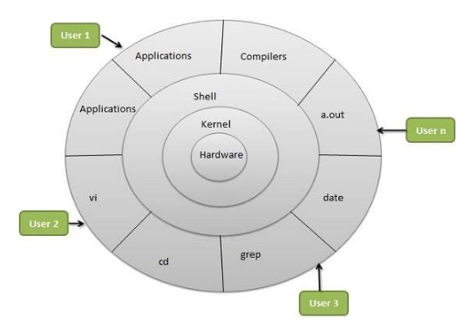
Architecture of linux

Slide 5
Hardware layer :
Hardware consists of all peripheral devices (RAM/ HDD/ CPU etc).
Kernel :
It is the core component of Operating System, interacts directly with hardware,
provides low level services to upper layer components.
Shell:
An interface to kernel, hiding complexity of kernel's functions from users.
The shell takes commands from the user and executes kernel's functions.
Utilities:
Utility programs that provide the user most of the functionalities
of an operating systems.

Slide 6
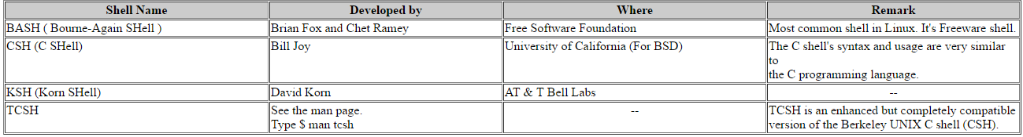
Linux Shell
Shell is a user program or it's environment provided for user
interaction. Shell is an command language interpreter that
executes commands read from the standard input device
(keyboard) or from a file.Shell is not part of system kernel,
but uses the system kernel to execute programs, create files.
Several shell available with Linux including:

Slide 7
Why to Write Shell Script ?
shell script can take input from user, file and output them on screen.
Useful to create our own commands.
Save lots of time.
To automate some task of day today life.
System Administration part can be also automated.

Slide 8
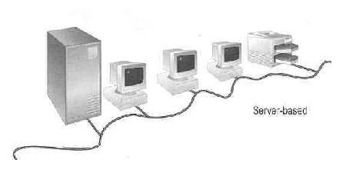
Linux User Login
Linux is a multiuser OS
Allow multiple users to use the resource of a computer at the same time
Every user needs to login the system with the password provided to identify their right in using the resource
Require for both client-server based system or desktop
Client-server based system
Linux Server
Paul
Peter
Mary
:
Peter: admin
Paul : general
Mary : intruder

Slide 9
Linux User Interface
User needs to type lines of command to instruct the computer to work, similar to DOS
Advantage: fast in speed. Very few resource is required for its implementation
Disadvantages: user needs to type, hence can easily make error. Besides, user needs to memorize all commands
Suitable for expert users and for the systems , such as servers
graphical user interface (GUI) is available for Linux:
Uses pointing devices (e.g. mouse) to control the system, similar to Microsoft’s Windows
Provide menu-driven and/or icon-driven interfaces
menu-driven: user is provided with a menu of choices. Each choice refers to a particular task
icon-driven: tasks are represented by pictures (icon) and shown to user. Click on an icon invokes one task
Advantages: No need to memorize commands. Always select task from menus or icons
Disadvantages: Slow and require certain resource for its implementation
Suitable for general users and systems, such as PC

Slide 10
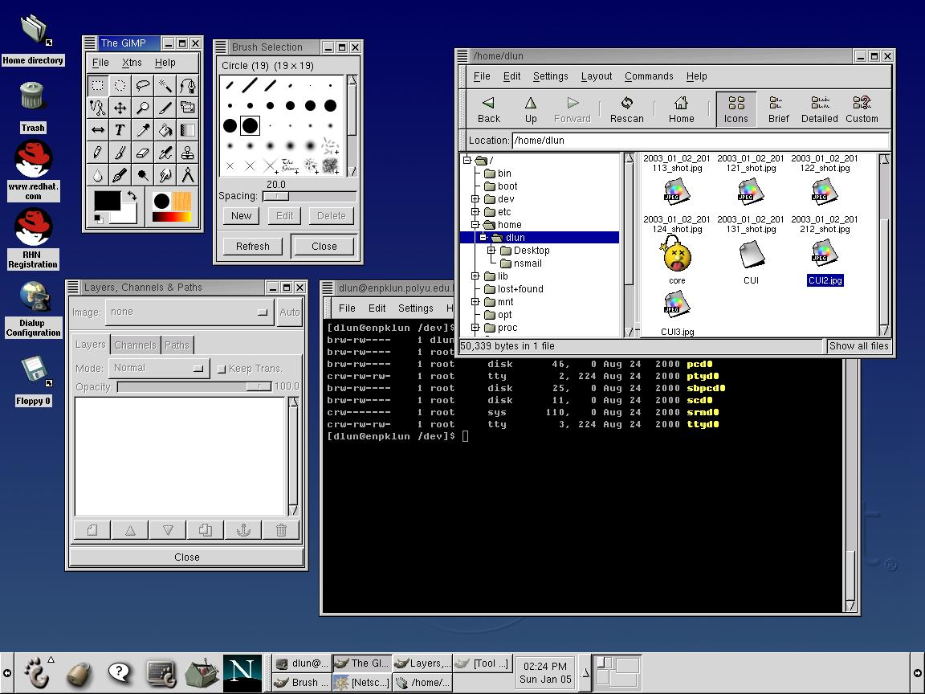
A typical Linux GUI based on GNOME
Similar to Microsoft’s Windows, however, different window systems can be chosen (e.g. GNOME, KDE, etc)

Slide 11
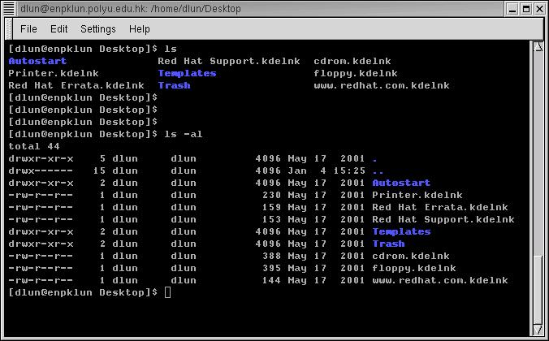
Linux text-based interface
command to show the content of current directory
The prompt $ shows that bash shell is using
command to show the content of current directory with option -al

Slide 12
LINUX Commands
File Commands
System commands

Slide 14
File Administration
ls : it will list the contents of the current directory in short form.
Cp sourcefile targetfile : Copies sourcefile to targetfile
mv sourcefile targetfile:
Copies sourcefile to targetfile then deletes the original sourcefile.
rm file(s): Removes the specified files from the file system. Directories are not removed by rm unless the option -r is used.
chown username.group file(s) :
Transfers the ownership of a file to the user with the specified user name.

Slide 15
File Administration (cont.)
chmod :changes the permissions of each given file according to mode, where mode describes the permissions to modify.
gzip file(s)
This command is used to compress the contents of files.
locate pattern(s)
The locate command can find in which directory a specified file is located.
find
The find command allows you to search for a file in a given directory

Slide 16
File Administration (cont.)
Working with Directories:
cd
Changes the current directory. cd without any
parameters changes to the user's home directory.
mkdir directoryname
Creates a new directory.
rmdir directoryname
Deletes the specified directory .

Slide 17
Commands to Access File Contents
cat file(s)
The cat command displays the contents of a file, printing the entire contents to the screen without interruption.
Less file(s)
This command can be used to browse the contents of the specified file. Scroll half a screen page up or down with PgUp and PgDn or a full screen page down with Space. Jump to the beginning or end of a file using Home and End. Press Q to exit the program.
diff file1 file2
The diff command compares the contents of any two files. The output produced by the program lists all lines that do not match.
Only reports whether the two given files differ.
grep searchstring filenames
The grep command finds a specific searchstring in the specified file(s). If the search string is found, the command displays the line in which the searchstring was found along with the file name.

Slide 18
File Systems
mount [<device>] mountpoint :
This command can be used to mount any data media, such as hard disks, CD-ROM drives, and other drives, to a directory of the Linux file system.
umount mountpoint :
This command unmounts a mounted drive from the file system. To prevent data loss, run this command before taking a removable data medium from its drive.

Slide 19
System Commands
1) System Information
2) Processes
3) Miscellaneous

Slide 20
System Information
df [directory]
The df (disk free) command displays information about the total disk space, free space,and the disk space currently in use.
du [path]
This command, shows the total disk space occupied by files and subdirectories in the current directory.
Date
This command displays the current system time and date.

Slide 21
Processes
top
top provides a quick overview of the currently running processes.
Ps [process ID] This command displays a table of all your own programs or processes — those you started.
kill process ID
kill sends a TERM signal that instructs the program to shut itself down.
killall processname
This command is similar to kill, but uses the process name (instead of the process ID) as an argument, causing all processes with that name to be killed.

Slide 22
Miscellaneous commands
passwd [username]
Users may change their own passwords at any time using this command
halt
To avoid loss of data, you should always use this program to shut down your system.
reboot
Does the same as halt with the difference that the system performs an immediate reboot.
clear
This command cleans up the visible area of the console

Slide 23
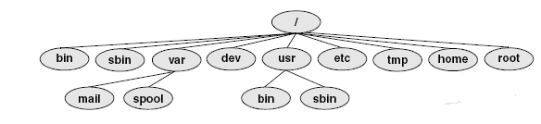
Linux file system structure:

Slide 24
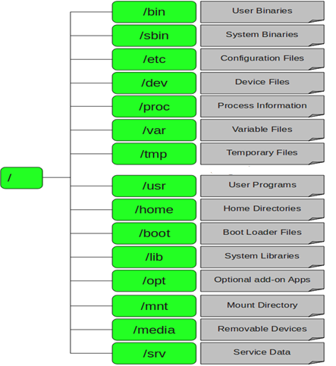

Slide 25
/Root:
Every single file and directory starts from the root directory.
Only root user has write privilege under this directory.
Please note that /root is root user’s home directory, which is not same as /.
/bin – User Binaries
Contains binary executables.
Common linux commands you need to use in single-user modes are located under this directory.
Commands used by all the users of the system are located here.
For example: ps, ls, ping, grep, cp.

Slide 26
/sbin – System Binaries:
Just like /bin, /sbin also contains binary executables.
But, the linux commands located under this directory are used typically by system aministrator, for system maintenance purpose.
For example: iptables, reboot, fdisk, ifconfig, swapon
/etc – Configuration Files:
Contains configuration files required by all programs.
This also contains startup and shutdown shell scripts used to start/stop individual programs.
For example: /etc/resolv.conf, /etc/logrotate.conf

Slide 27
/dev – Device Files
Contains device files.
These include terminal devices, usb, or any device attached to the system.
For example: /dev/tty1, /dev/usbmon0
/proc – Process Information
Contains information about system process.
This is a pseudo filesystem contains information about running process. For example: /proc/{pid} directory contains information about the process with that particular pid.
This is a virtual filesystem with text information about system resources. For example: /proc/uptime

Slide 28
/var – Variable Files:
var stands for variable files.
Content of the files that are expected to grow can be found
under this directory.
This includes — system log files (/var/log); packages and
database files (/var/lib); emails (/var/mail); print queues
(/var/spool); lock files (/var/lock); temp files needed across
reboots (/var/tmp);
/tmp – Temporary Files
Directory that contains temporary files created by system
and users.
Files under this directory are deleted when system is
rebooted.

Slide 29
/usr – User Programs :
Contains binaries, libraries, documentation, and source-code
for second level programs.
/usr/bin contains binary files for user programs. If you can’t
find a user binary under /bin, look under /usr/bin.
/usr/sbin contains binary files for system administrators.
If you can’t find a system binary under /sbin, look under
/usr/sbin. For example: useradd, userdel
/usr/lib contains libraries for /usr/bin and /usr/sbin
/usr/local contains users programs that you install from source.
For example, when you install apache from source, it goes
under /usr/local/apache2
/home – Home Directories
Home directories for all users to store their personal files.
For example: /home/john, /home/nikita

Slide 30
/mnt – Mount Directory
Temporary mount directory where sysadmins can
mount filesystems.
/media – Removable Media Devices
Temporary mount directory for removable devices.
For examples, /media/cdrom for CD-ROM; /media/
floppy for floppy drives; /media/cdrecorder for CD writer
/srv – Service Data
srv stands for service.
Contains server specific services related data.
For example, /srv/cvs contains CVS related data.

Slide 31
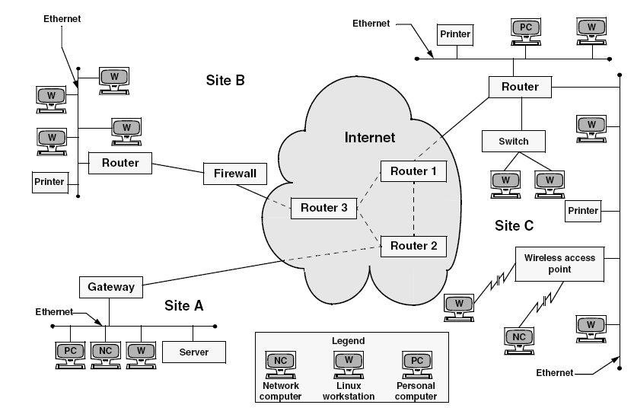
Networking and the Internet

Slide 32
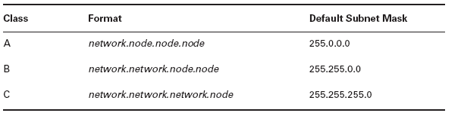
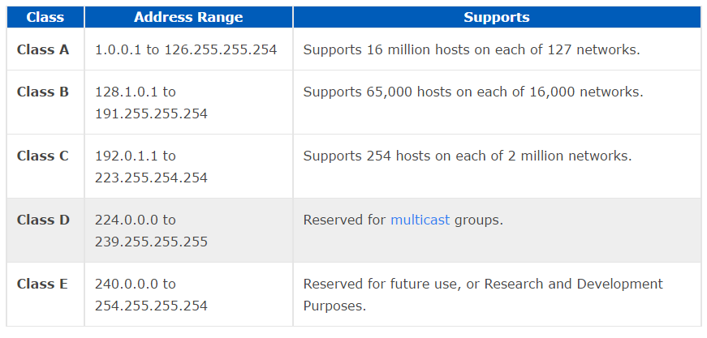
Subnet mask:
Class of Ip Address

Slide 33
Networking
telnet: Logs In on a Remote System
ftp: Transfers Files Over a Network
ping: Tests a Network Connection
traceroute: Traces a Route Over the Internet
host : Query Internet Nameservers
whois: Looks Up Information About an Internet Site

Slide 34
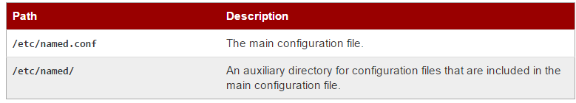
DNS: Domain Name Service
allows you to type names into your Web browser like acm.nitt.edu(10.0.0.2) and your computer to automatically find that address on the Internet. A key element of the DNS is a worldwide collection of DNS servers.
Configuring DNS

Slide 35
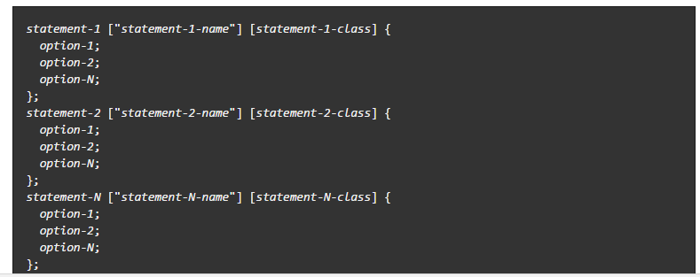
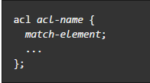
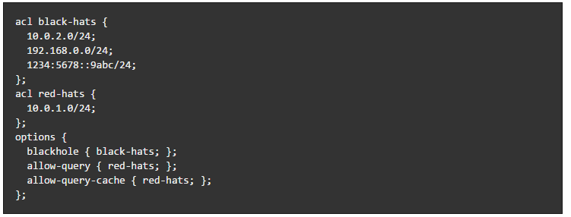
Named.conf

Slide 36
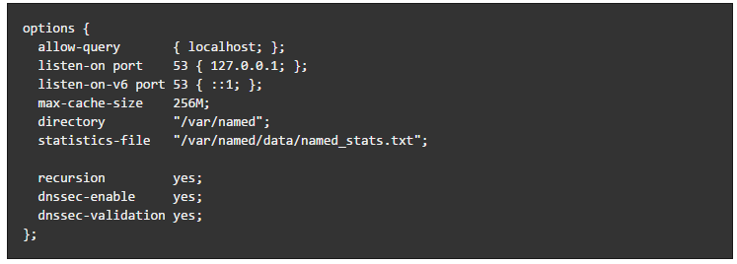
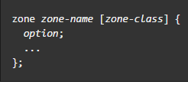
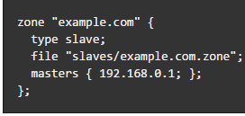
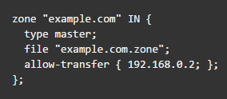

Slide 37

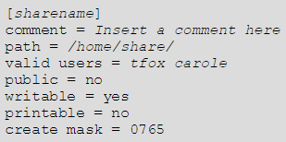
Configuring a Samba Server
The default configuration file /etc/samba/smb.conf allows
users to view their home directories as a Samba share.

Slide 38
USES
Embedded devices
Home theater PC
Digital security
Gaming
Education
In space
Smart devices
smartphones,
tablet computers,
smart TVs,
in-vehicle infotainment
Android,
Firefox OS,
Desktop
GNOME, has its human interface guidelines as a design guide, which gives the human–machine interface an important role, not just when doing the graphical design, but also when considering people with disabilities, and even when focusing on security.
Servers, mainframes and supercomputers
Linux distributions have long been used as server operating systems, popular on mainframes, and used as operating systems for supercomputers .

Slide 39
THANK YOU

